Slide 1
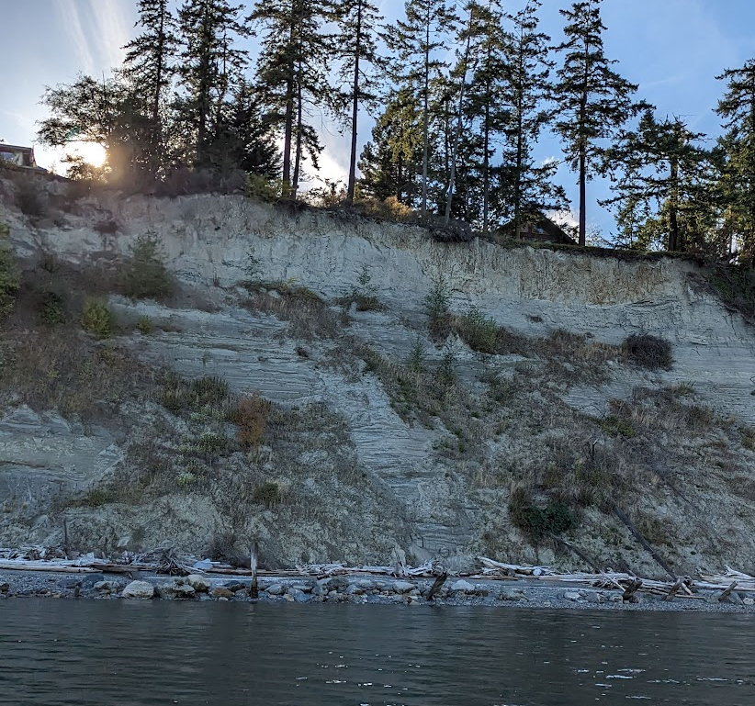
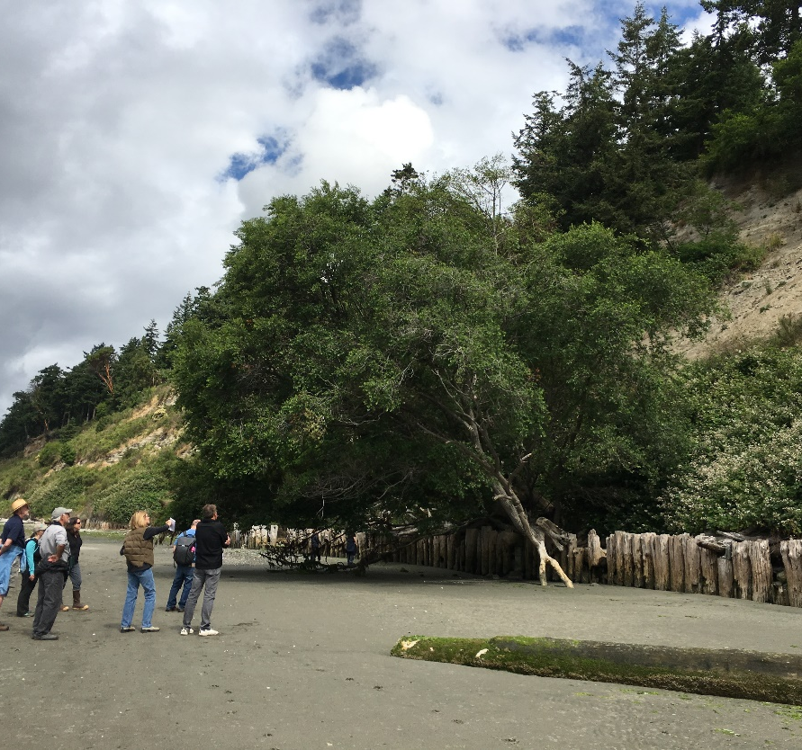
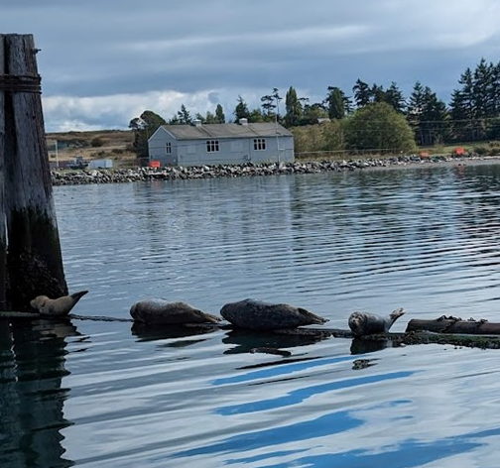

Island County Shoreline Hard Armor Mapping & Change Analysis
Teams Presentation | May 7, 2024
Notes:
Introductions (Andrea & Lauren)

Slide 2

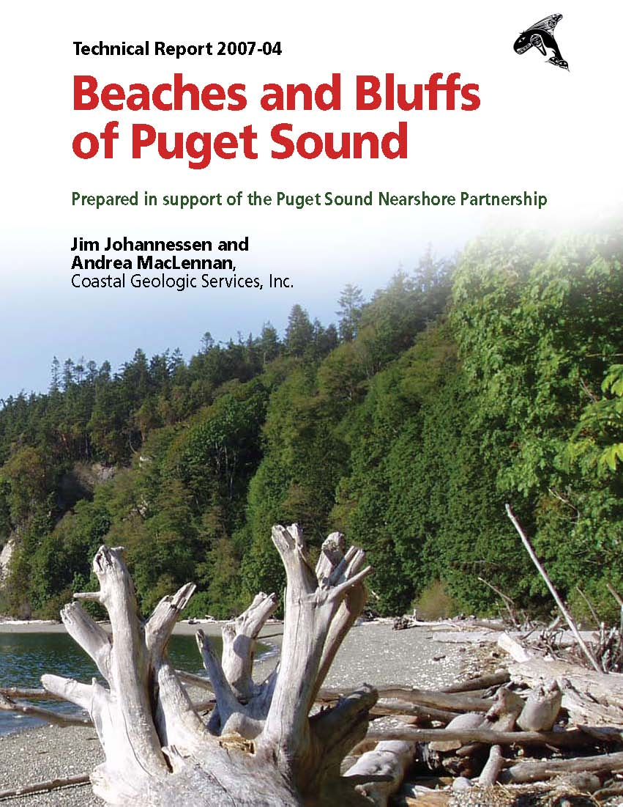
Puget Sound Interconnected components
Notes:
Andrea

Slide 3
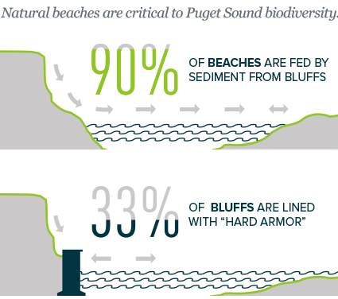
SHORELINE ARMOR
Impacts of Shore Armor
Burial of beach
Loss of backshore berm
Increase wave reflection
Beach scour/erosion
Loss of fines (sands)
Impacts to littoral drift
Reduced sediment input
Proliferation and expansion
Habitats simplified/lost
Notes:
Andrea

Slide 4
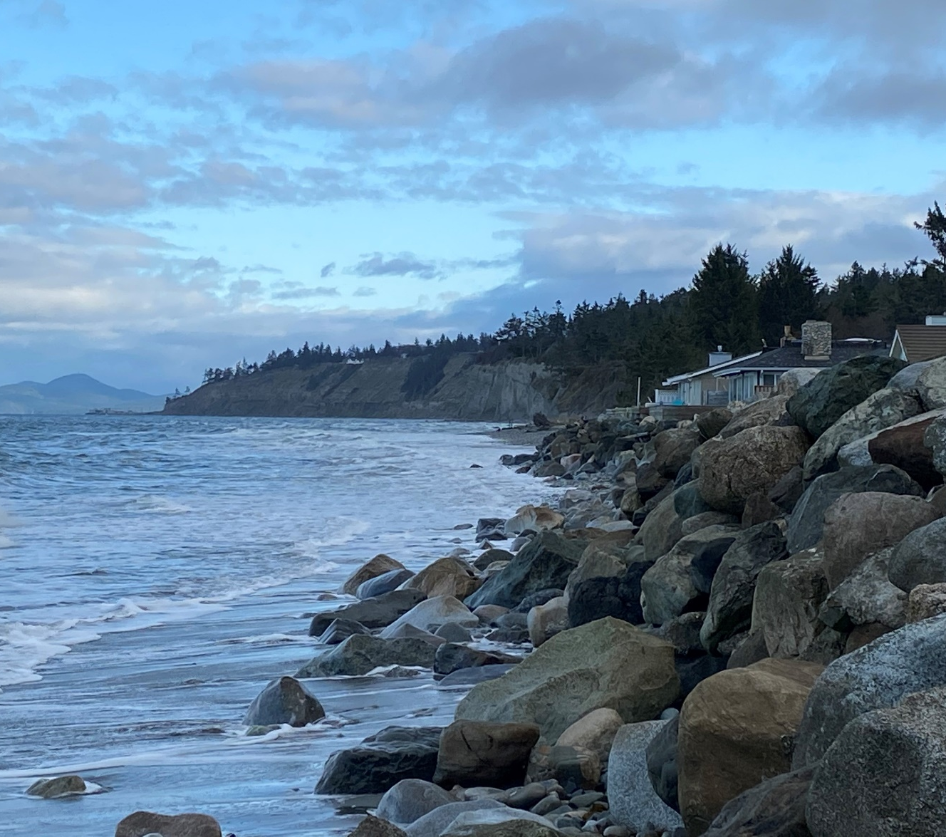
Mapping SHORELINE ARMOR in Island County
Mapping Objectives
Repeat Methods from 2016 mapping
Measure Armor Change
Characterize nature of change
Pair with Permit Analysis
Evaluate types of permits and actions
Notes:
Andrea

Slide 5
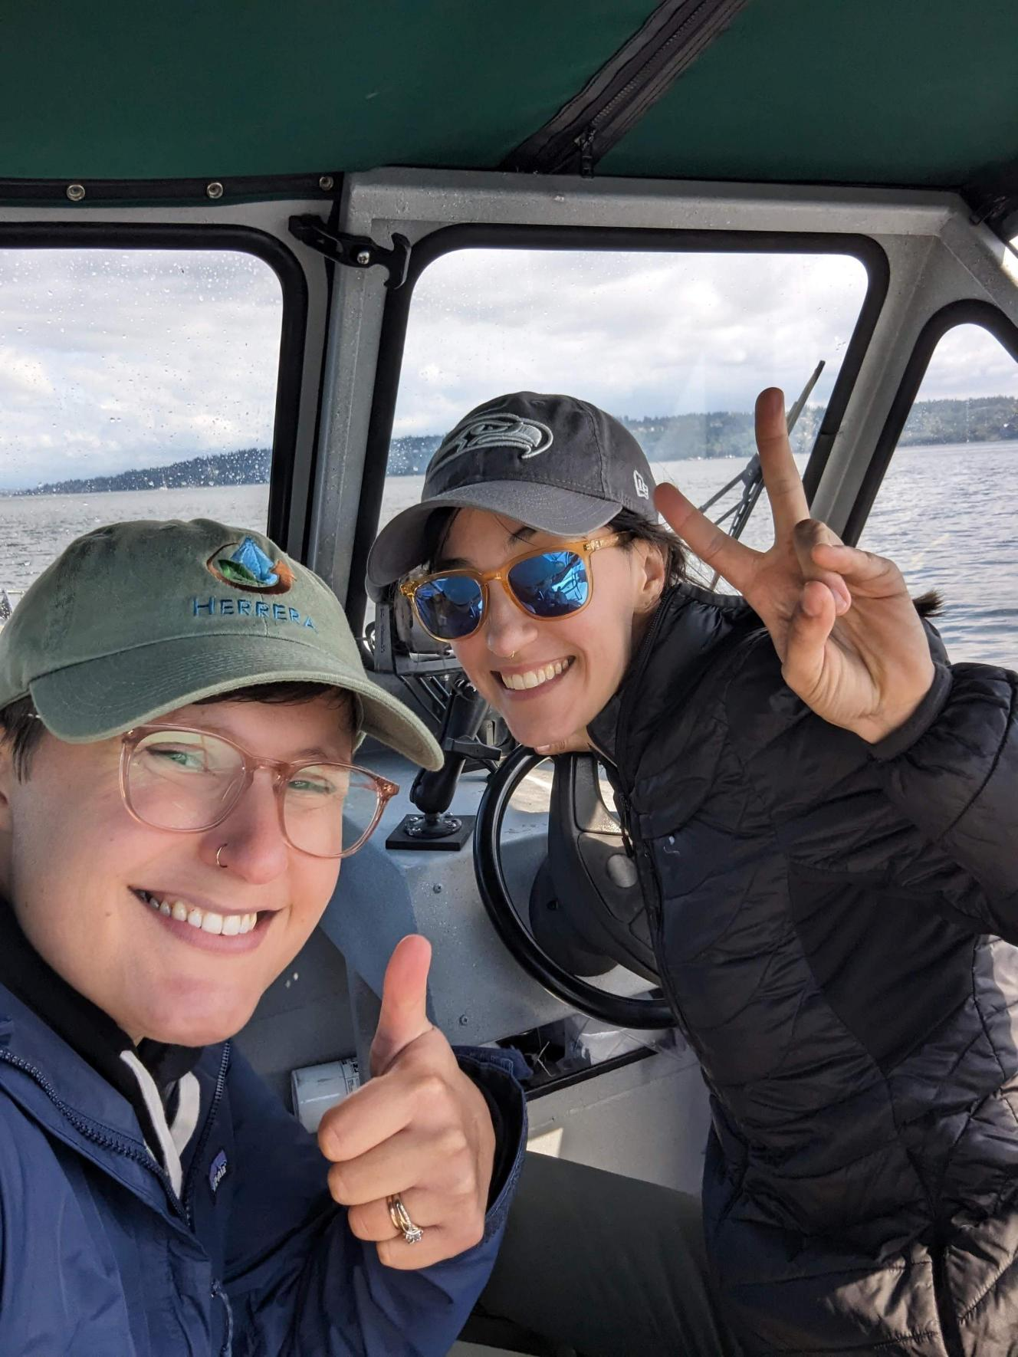
Shoreline Armor Mapping Methods
Boat-based mapping
Desktop post-processing and analysis
Association of armor changes with permit records
Notes:
Lauren

Slide 6
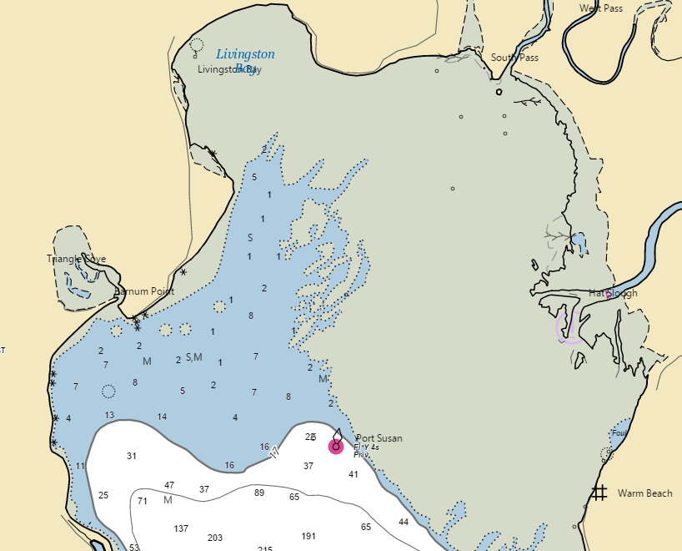
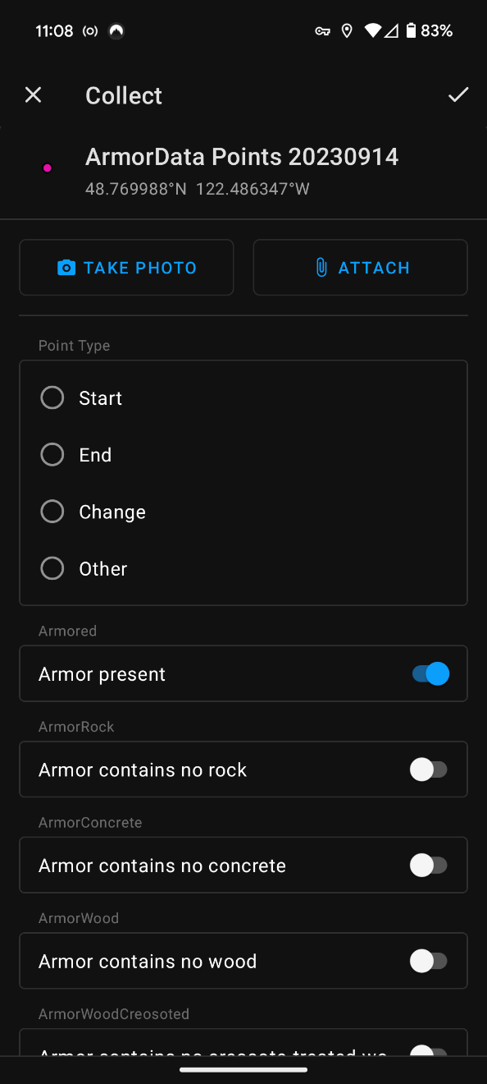
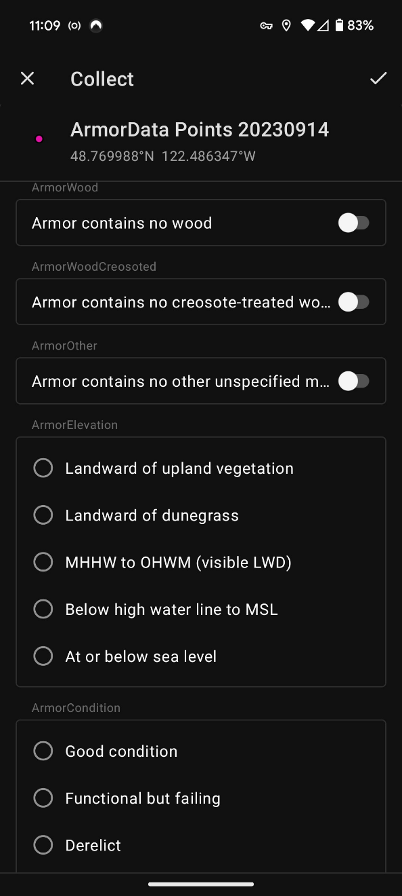
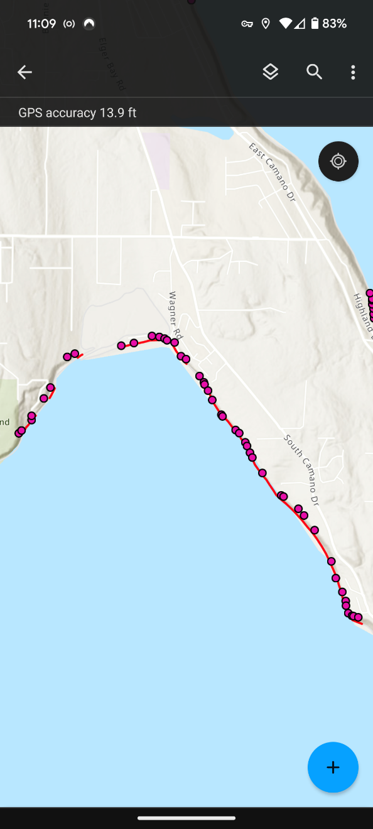
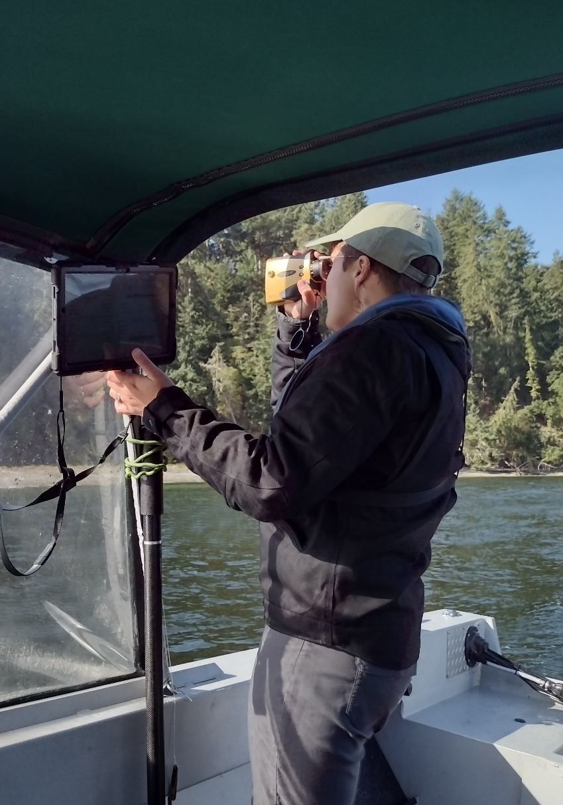
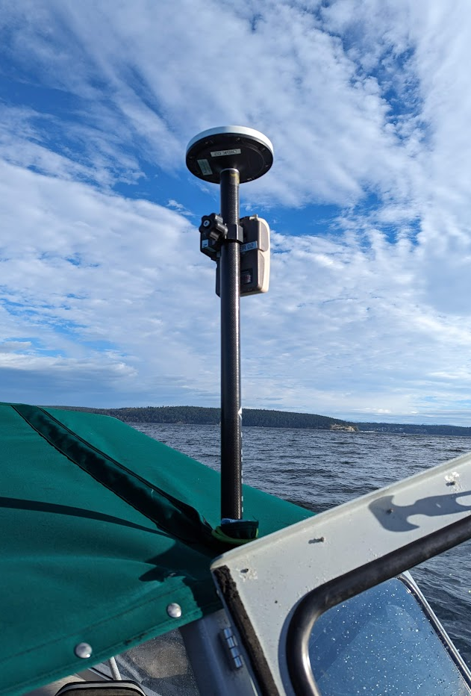

Shoreline Armor mapping methods
Boat-based mapping
GNSS GPS + Laser Rangefinder
Digital Field Form
High-tide cycle for shallow areas
Notes:
Lauren
GPS unit with real-time kinematic corrections in the field paired with a laser rangefinder to do offset mapping
Will explain in a little more detail
Map by boat in order to move nimbly and get access to shores
Use digital field form for efficiency and consistency
Scheduled mapping to reach shallow areas at high tides

Slide 7

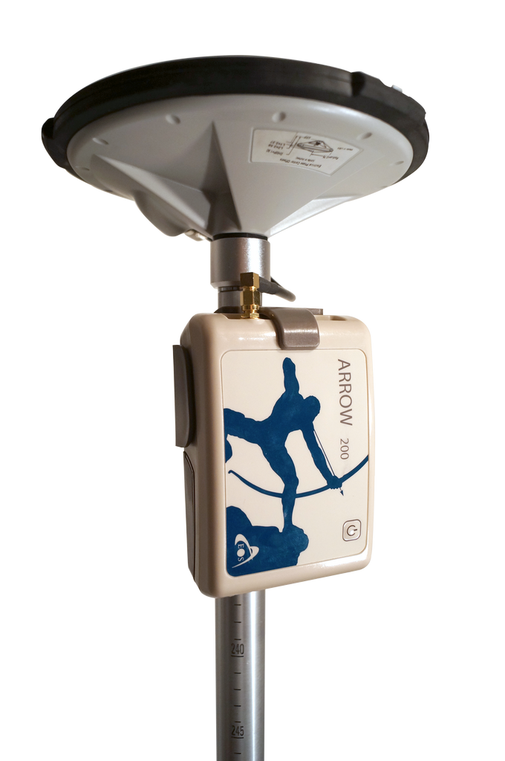
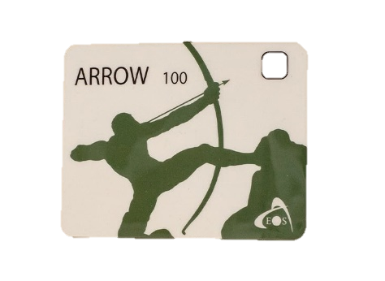
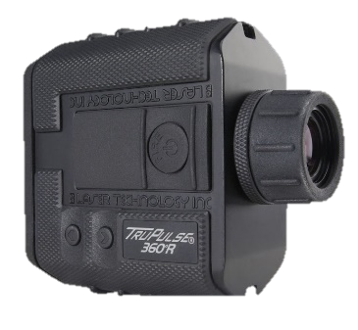
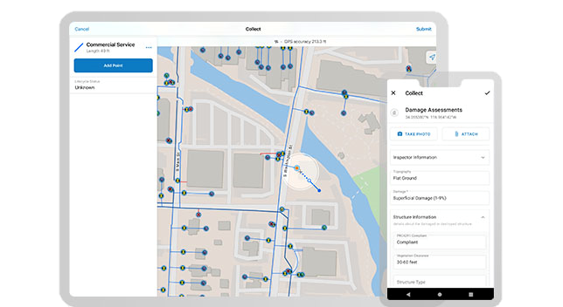

Laser Offset Mapping
How it works:
Collect a GPS point
Within digital field form, “offset” the GPS point
Fire the laser rangefinder at the mapping target
The GPS point is shifted in FieldMaps to the target location
Notes:
Lauren

Slide 8
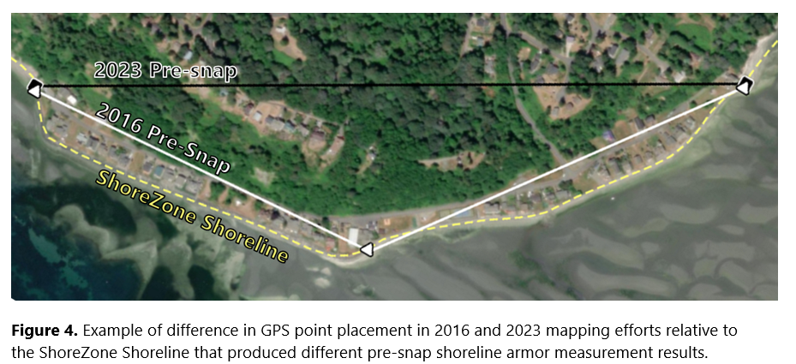
Post-Processing and Analysis Approach
Desktop post-processing and analysis
Compared “pre-snap” and ShoreZone-conforming armor geometry
Analyzed for changes in:
Presence/absence
Elevation
Condition
Summarized by shoretype, forage fish impacts
Notes:
Lauren

Slide 9
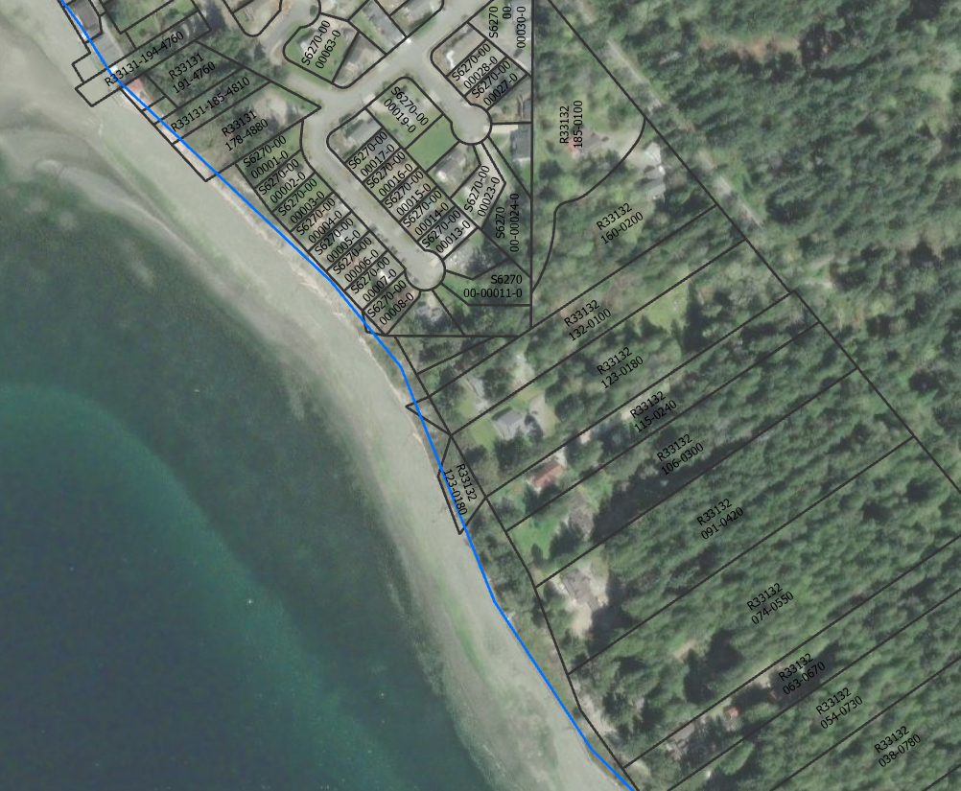

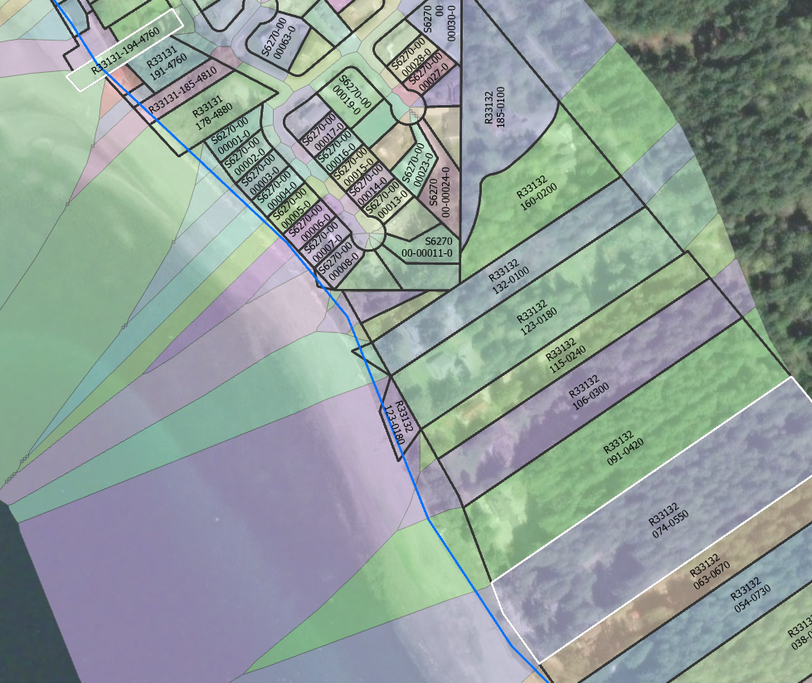
Permit Analysis approach
Unify and summarize permit records across jurisdictions
Associate tax parcels with permit records by Parcel ID
Extend coastal parcels to intersect armor records (ShoreZone Shoreline-conforming)
Spatially intersect and summarize mapped change (armor line) against issued permits (from tax parcels)
Parcel Number | Jurisdiction | Permit Number | Permit Type | Permit Description | Project Name | Project Description | Permit Issued | Permit Status Description | Armor Permit | Soft shore permit | Other permit (dock footing, etc.) | After the fact | Emergency | Approved | Install | Repair | Remove | Replace | Modify
R13202-268-4820 | Oak Harbor |  | Shoreline maintenance exemption | Armor repair and stormwater outfall repair | Armor repair and stormwater outfall repair | Armor repair and stormwater outfall repair 80 LF | 10/19/2018 | Approved | 1 |  |  |  |  | 1 |  | 1
R13232-173-0200 | Island County | 373/20 | PL-SHE-II | Shoreline Exemption, Type II | Demolish existing house, replace bulkhead and construct new SFR and appurtenances |  |  | Approved with Conditions | 1 |  |  |  |  | 1 |  |  |  | 1
R13233-410-3750 | Coupeville | SSD-23-001 |  | Sea wall | Sea wall | Sea wall |  | Denied | 1 |  |  |  |  |  | 1
R13332-238-0170 | Island County | 273/22 | PL-SHE-II | Shoreline Exemption, Type II | Hayes bulkhead | Replacement of rock bulkhead with concrete bulkhead |  | Permit application is technically complete | 1 |  |  |  |  |  |  |  |  | 1
R13332-247-0220 | Island County | 159/19 | PL-SHE-II | Shoreline Exemption, Type II | Repair of existing 120 linear ft rock riprap bulkhead | Repair of existing 120 linear ft rock riprap bulkhead | 6/14/2019 | Approved with Conditions | 1 |  |  |  |  | 1 |  | 1
Notes:
Lauren

Slide 10
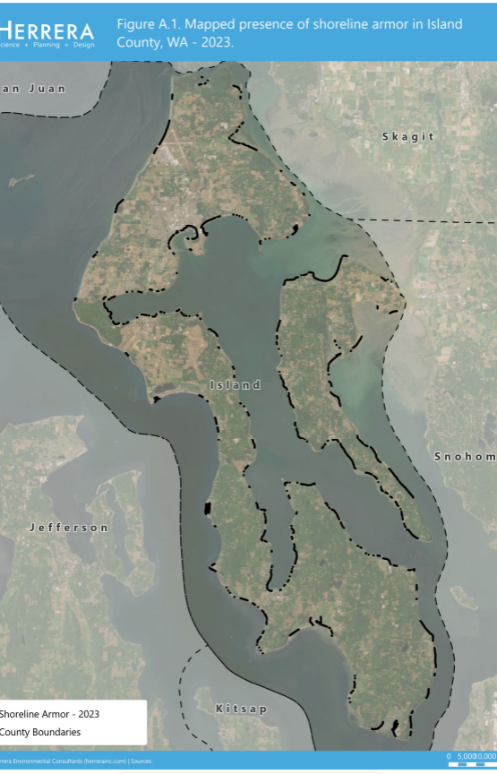
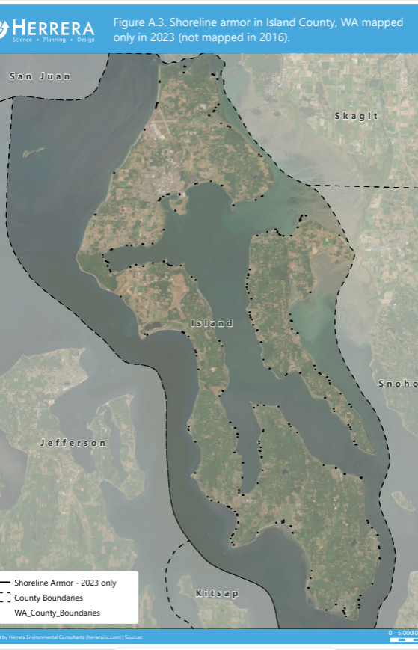
Shoreline Armor Mapping & Change
Notes:
Lauren

Slide 11
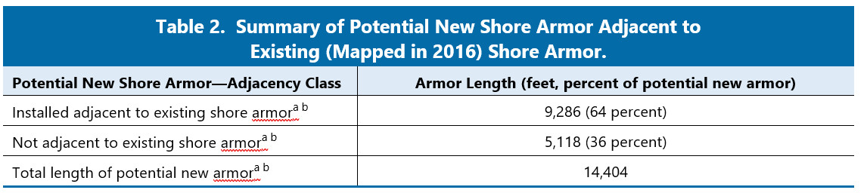

Shoreline Armor Change REsults
Island County armor change (2016 to 2023):
391 new armor segments
Mappers observed active shore armor construction at 4 locations
64% of new armor installed adjacent to existing armor
Notes:
Lauren
391 new armor segments identified between 2016 and 2023 mapping events
Of those, 117 segments were greater than 20 feet in length
Of 4 armor sites noted in construction during mapping, One was confirmed to be unpermitted
By length, 64% of new armor

Slide 12
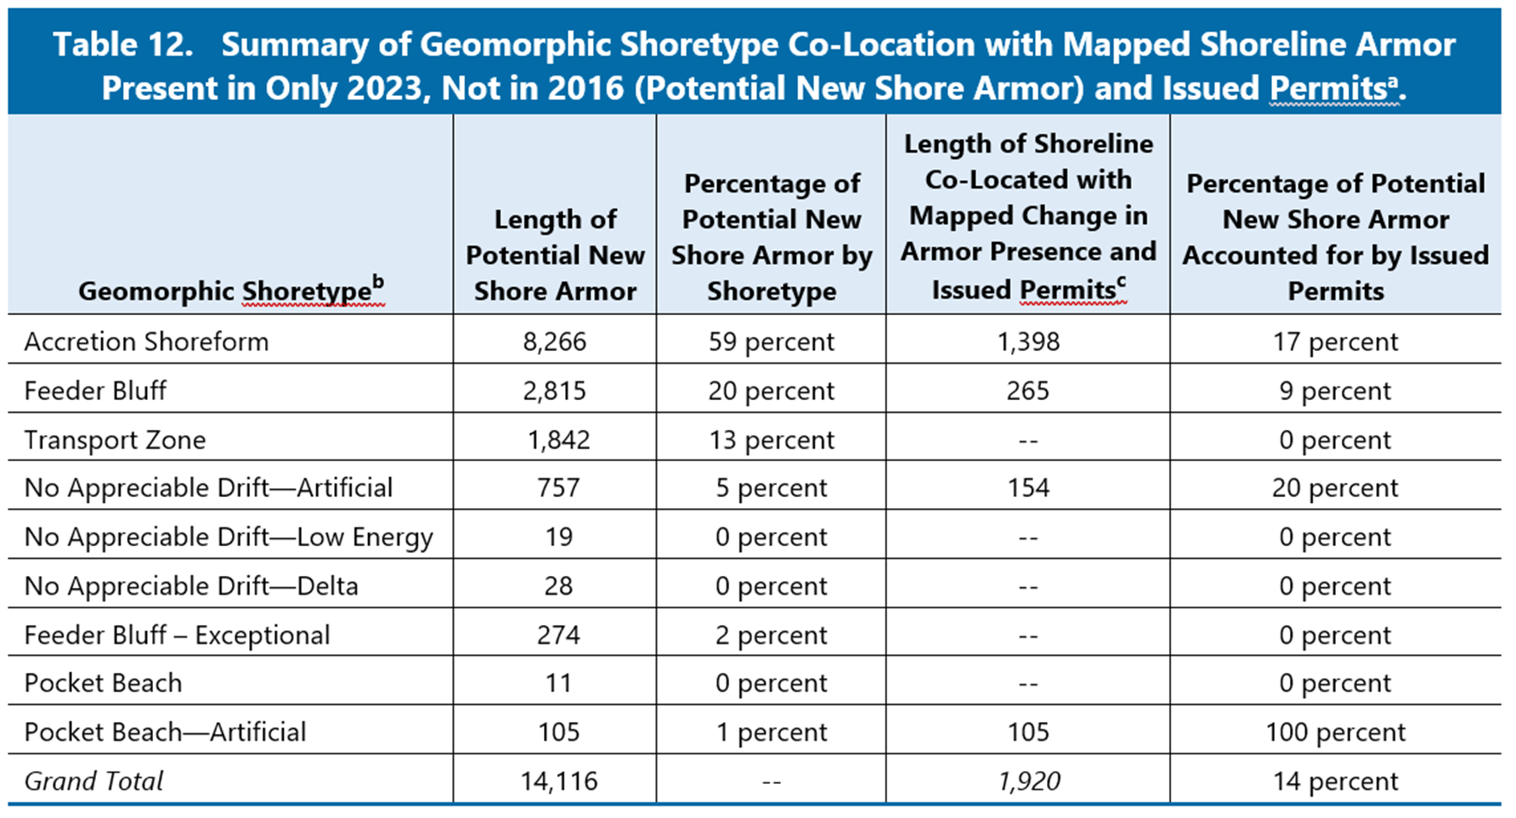

Shoreline Armor CHANGE Results
Accretion shoreforms and feeder bluff most frequently armored
59% of new armor on accretion shoreforms
20% of new armor on feeder bluffs
Notes:
Lauren
Armoring of accretion shoreforms – loss of beach resilience to SLR
Armoring of bluffs – loss of sediment inputs to sustain down-drift beaches and forage fish spawning habitat

Slide 13
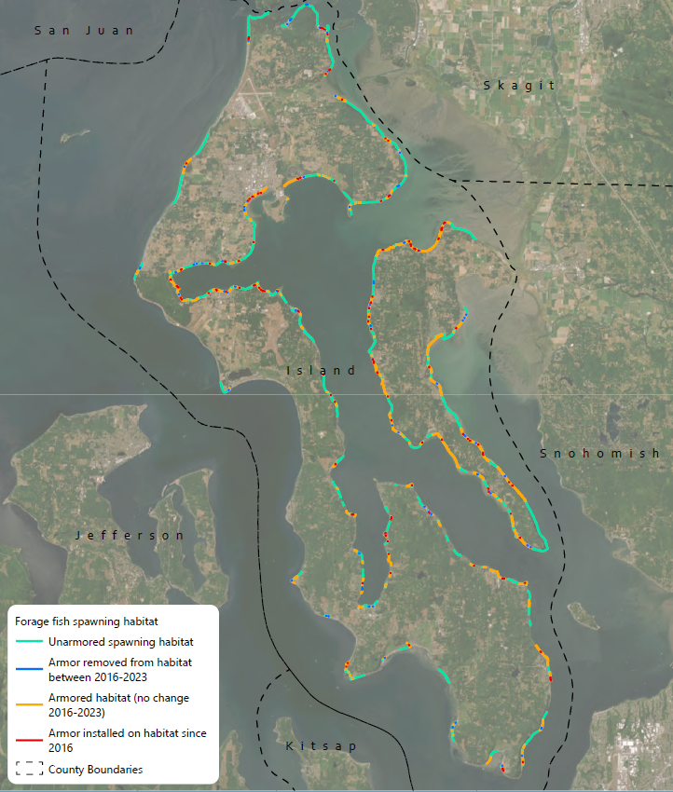
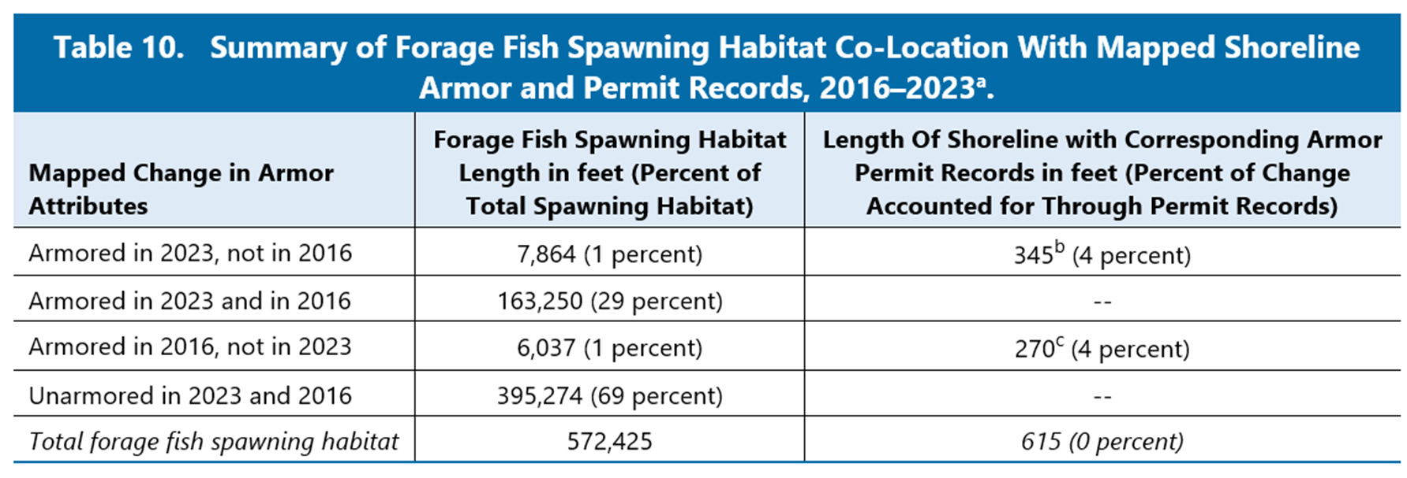
Shoreline Armor CHANGE Results
30% of forage fish spawning habitat was armored in 2023
29% of habitat armored in both 2016 and 2023
New armor on 1.3% of habitat
Armor removed from 1% of forage fish spawning habitat
Notes:
Lauren
165,100 feet of ffs habitat armored in 2023 mapping

Slide 14
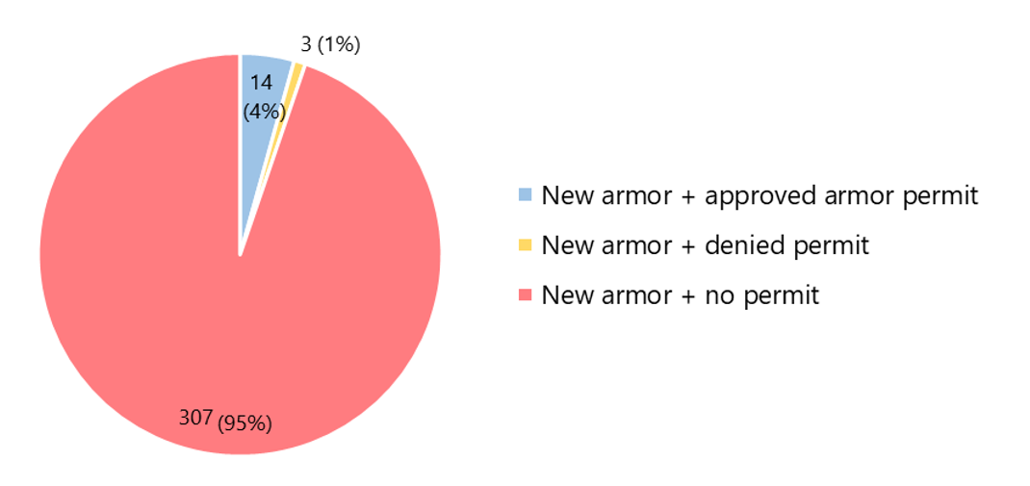
Permit Analysis
New Armor + Permit Associations (Count of Parcels)
Notes:
Lauren
New armor associated with 325 parcels
Of those parcels,
15 (4%) had an approved permit for new armor
2 (1%) had submitted a permit for new armor, but were denied
308 (95%) submitted no permit applications

Slide 15
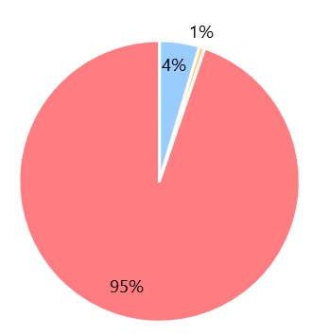
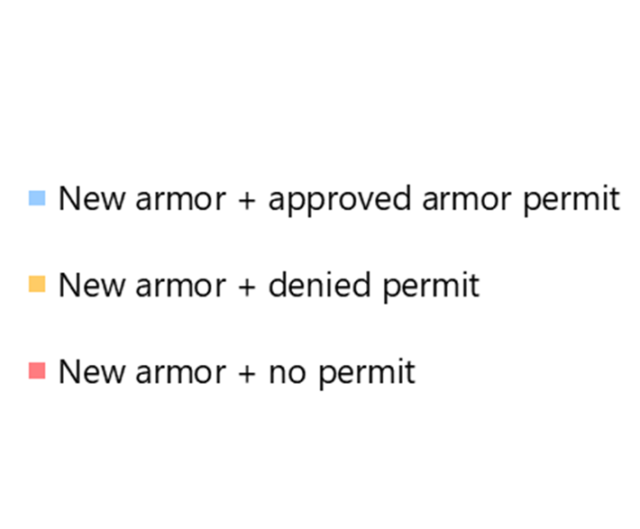
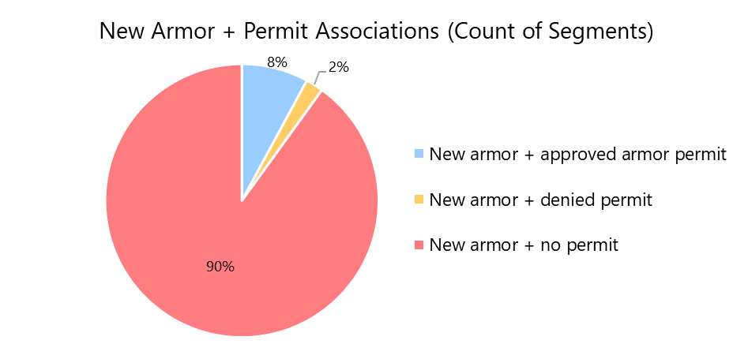
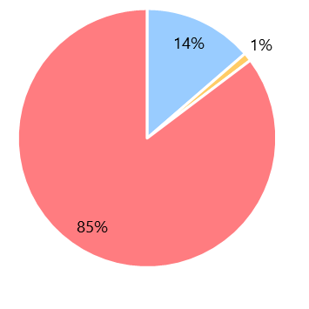
Permit Analysis
New Armor + Permit Associations
(Count of Parcels)
New Armor + Permit Associations
(Length)
Notes:
Lauren
14,119 feet of new armor across 325 parcels
New armor was permitted along 1,930 feet (14% of new armor)
New armor was installed with a denied permit along 150 feet (2% of new armor by length)
New armor installed with no permit records along remaining 12,040 feet (84%)

Slide 16
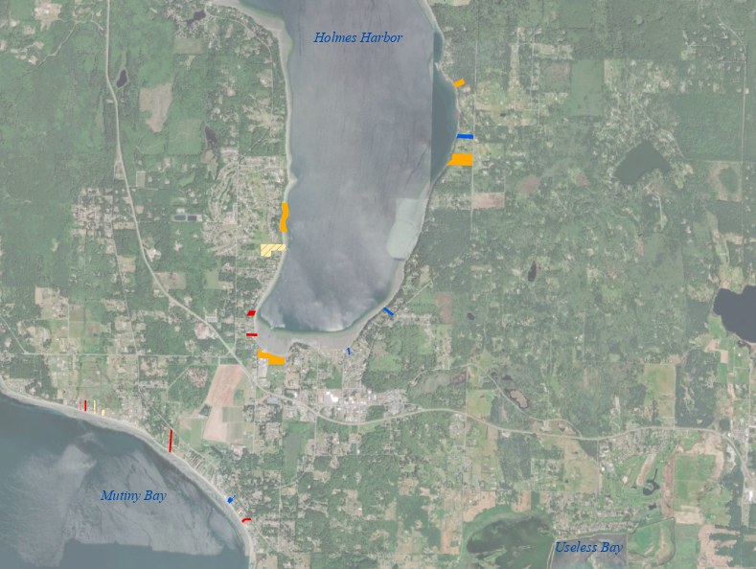
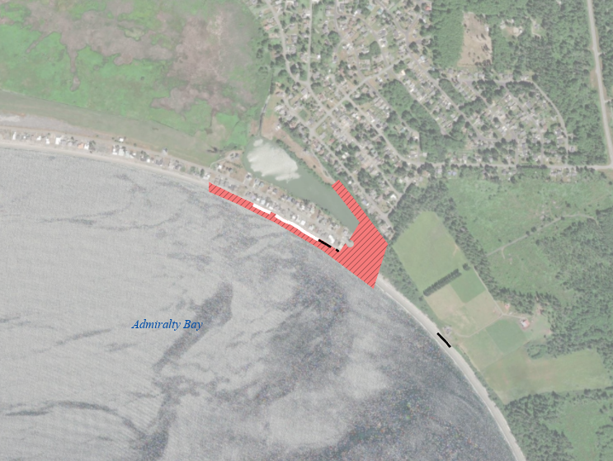
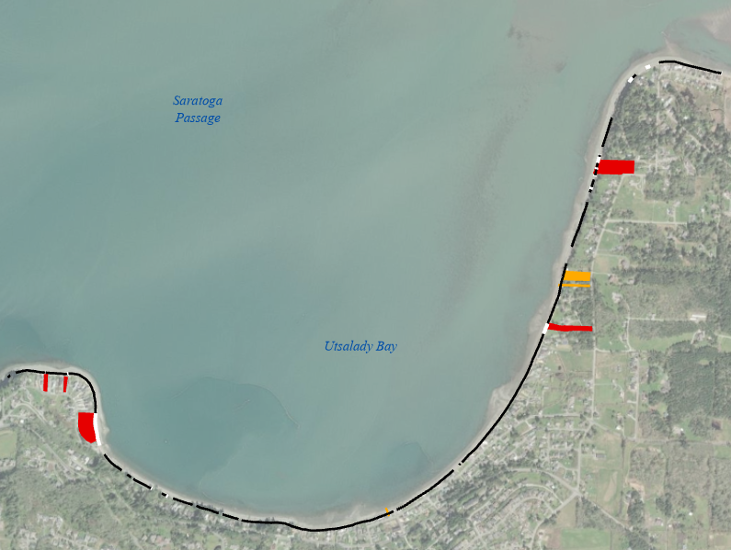
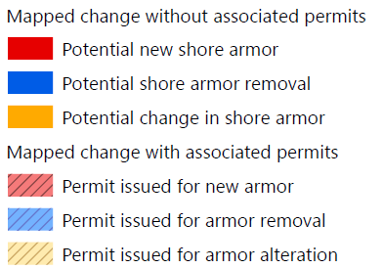
Permit Analysis
Widespread permitted and unpermitted change
Most change clustered in existing developments
Some parcels had more than one permit
Example sites:
Notes:
Lauren
Example – Utsalady Bay
Black line – existing armor
White line – new armor
Red parcels – new armor mapped, no issued permit
Orange parcels – armor modification mapped, no issued permit
Example – Admiralty Bay
Black line – existing armor
White line – new armor
Red hatched parcel – new armor with permit

Slide 17
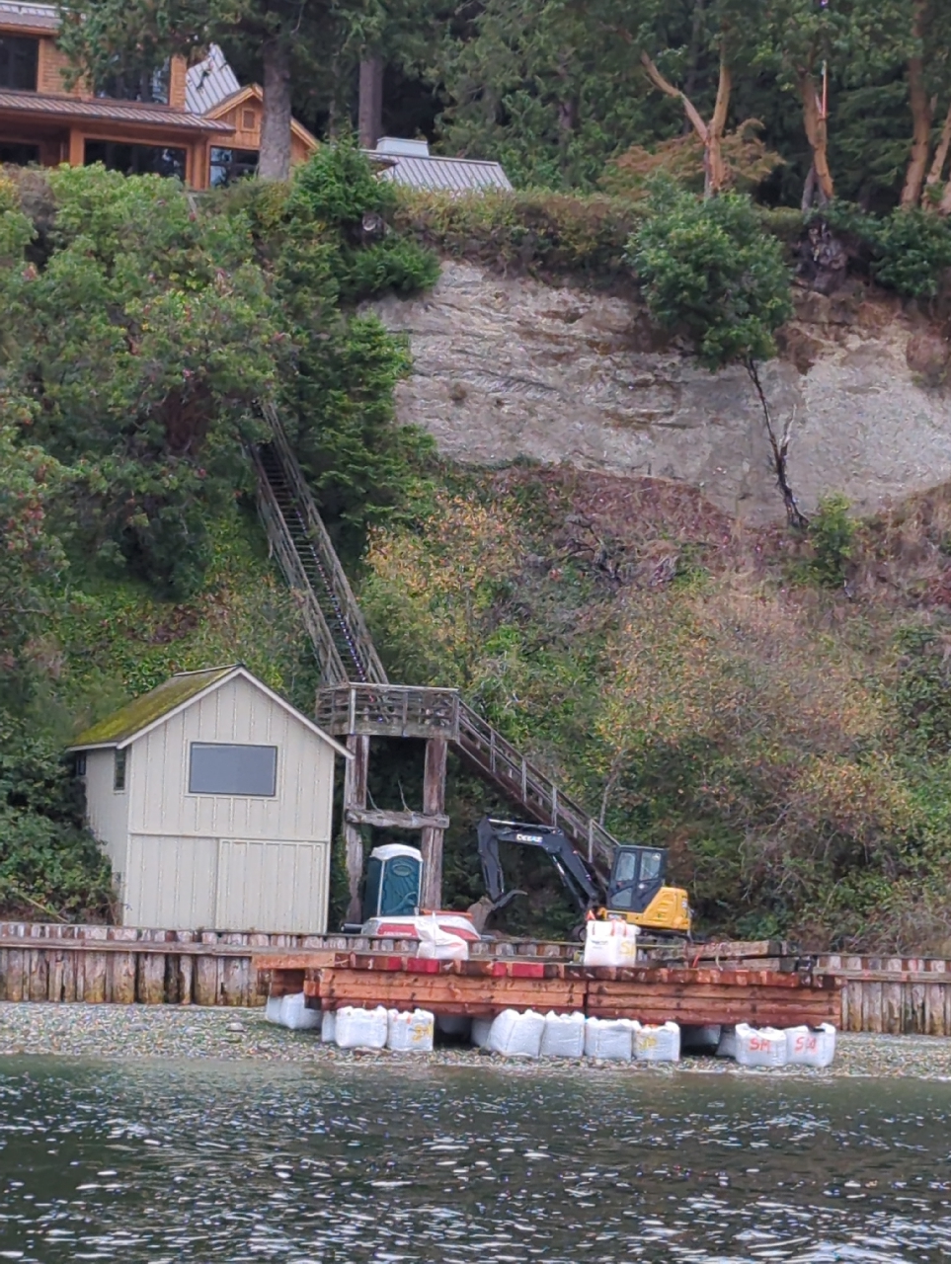
Discussion
Considerable lengths of unpermitted and permitted armor change were documented since 2016
Additional verification of armor on unpermitted activities should be conducted before pursuing action:
Mapping event photos and historical air photos
Legacy permits
Ongoing compliance monitoring and armor change mapping are valuable tools for enforcement and preserving long-term shoreline functions
Notes:
Andrea

Slide 18
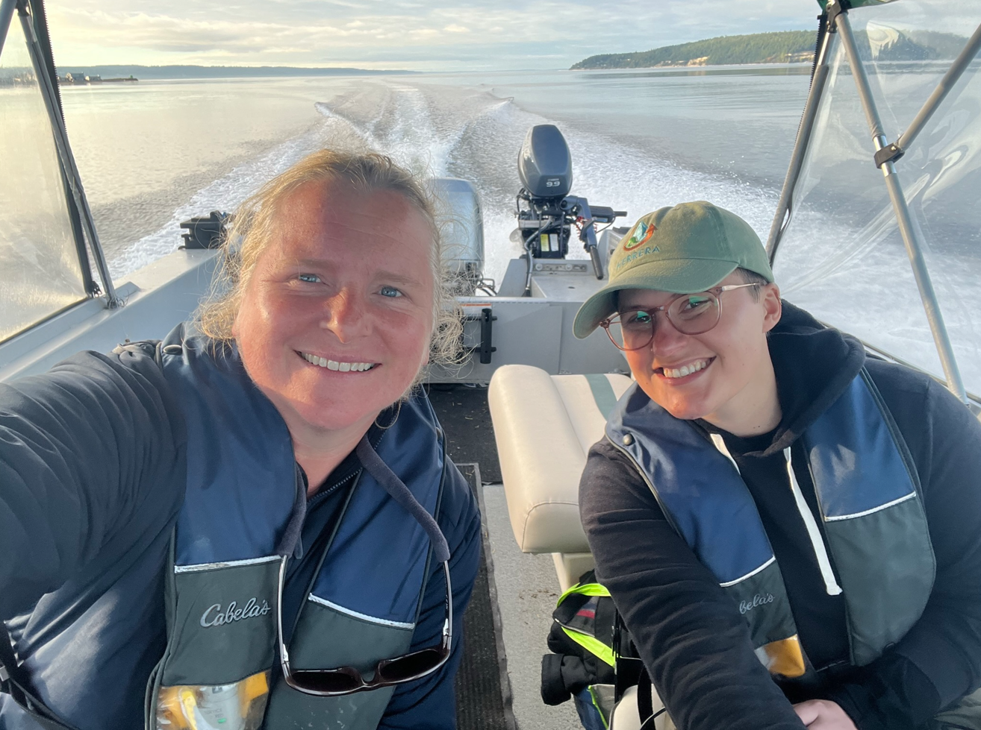
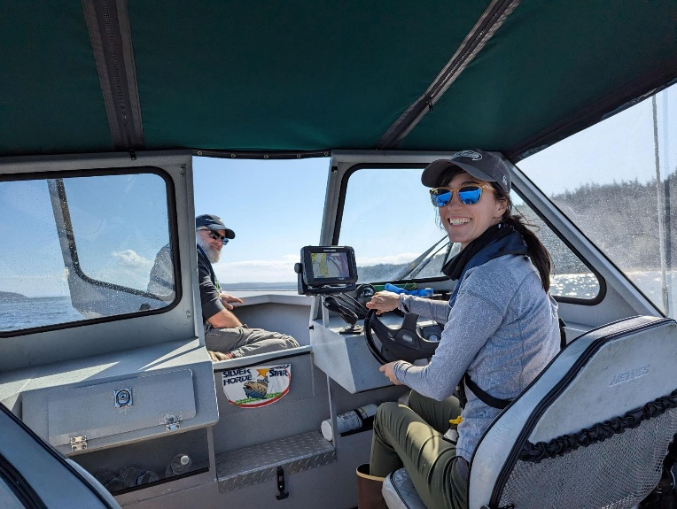

Question & Answer
Notes:
Andrea

