Slide 1
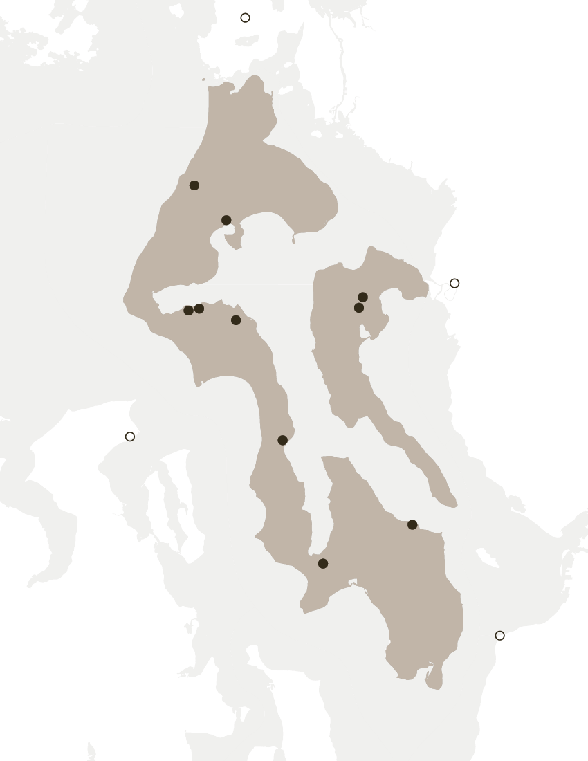
ISLAND REGION VEHICLE ELECTRIFICATION STUDY
Island Regional Transportation Planning Organization
TAC update
January 14, 2020

Slide 2
BUILDING CodeS

Slide 3
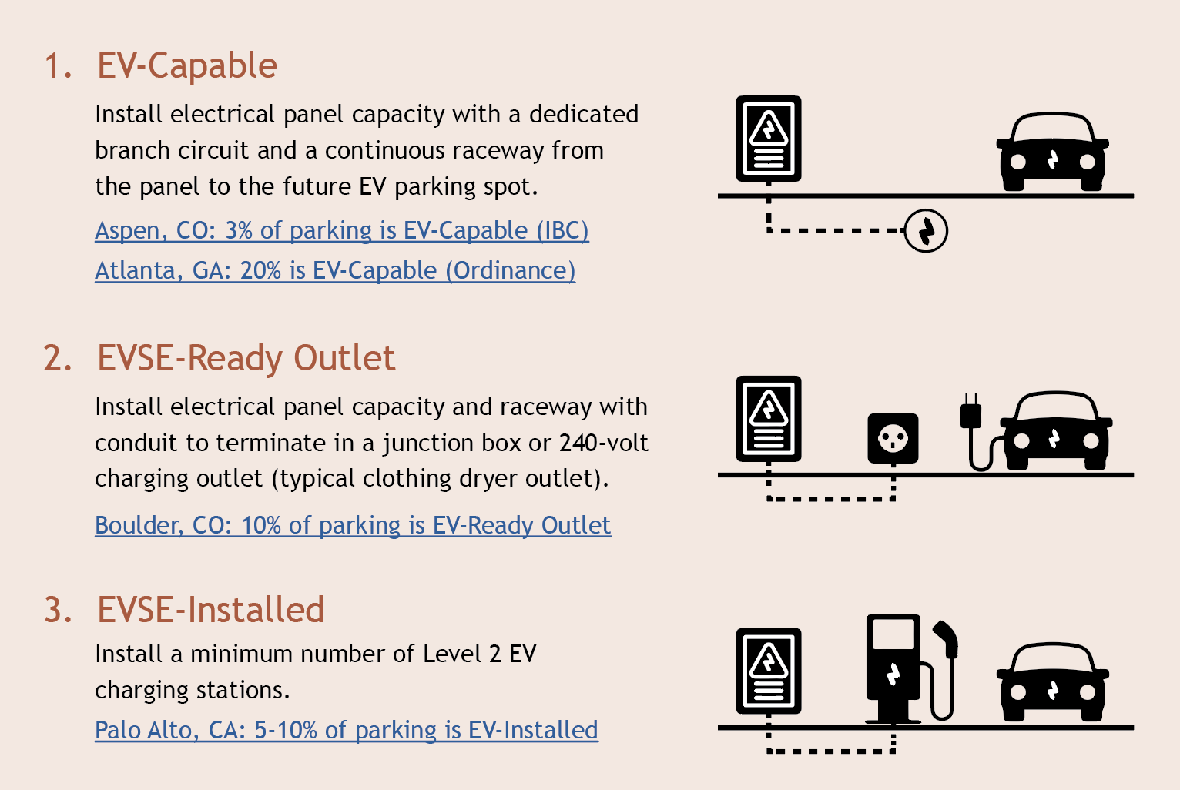
WHY CODES?
Updating building codes will ensure new homes, buildings, and parking facilities will be ready for electric vehicles and avoid expensive retrofit costs in the future
EV-READY CODE TYPES
EV-CAPABLE
EVSE-READY OUTLET
EVSE-INSTALLED
Install electrical panel capacity with a dedicated branch circuit and a continuous raceway from the panel to the future EV parking spot.
Install electrical panel capacity and raceway with conduit to terminate in a junction box or 240-volt charging outlet
Install a set number of Level 2 EV charging stations
Source: Southwest Energy Efficiency Project

Slide 4
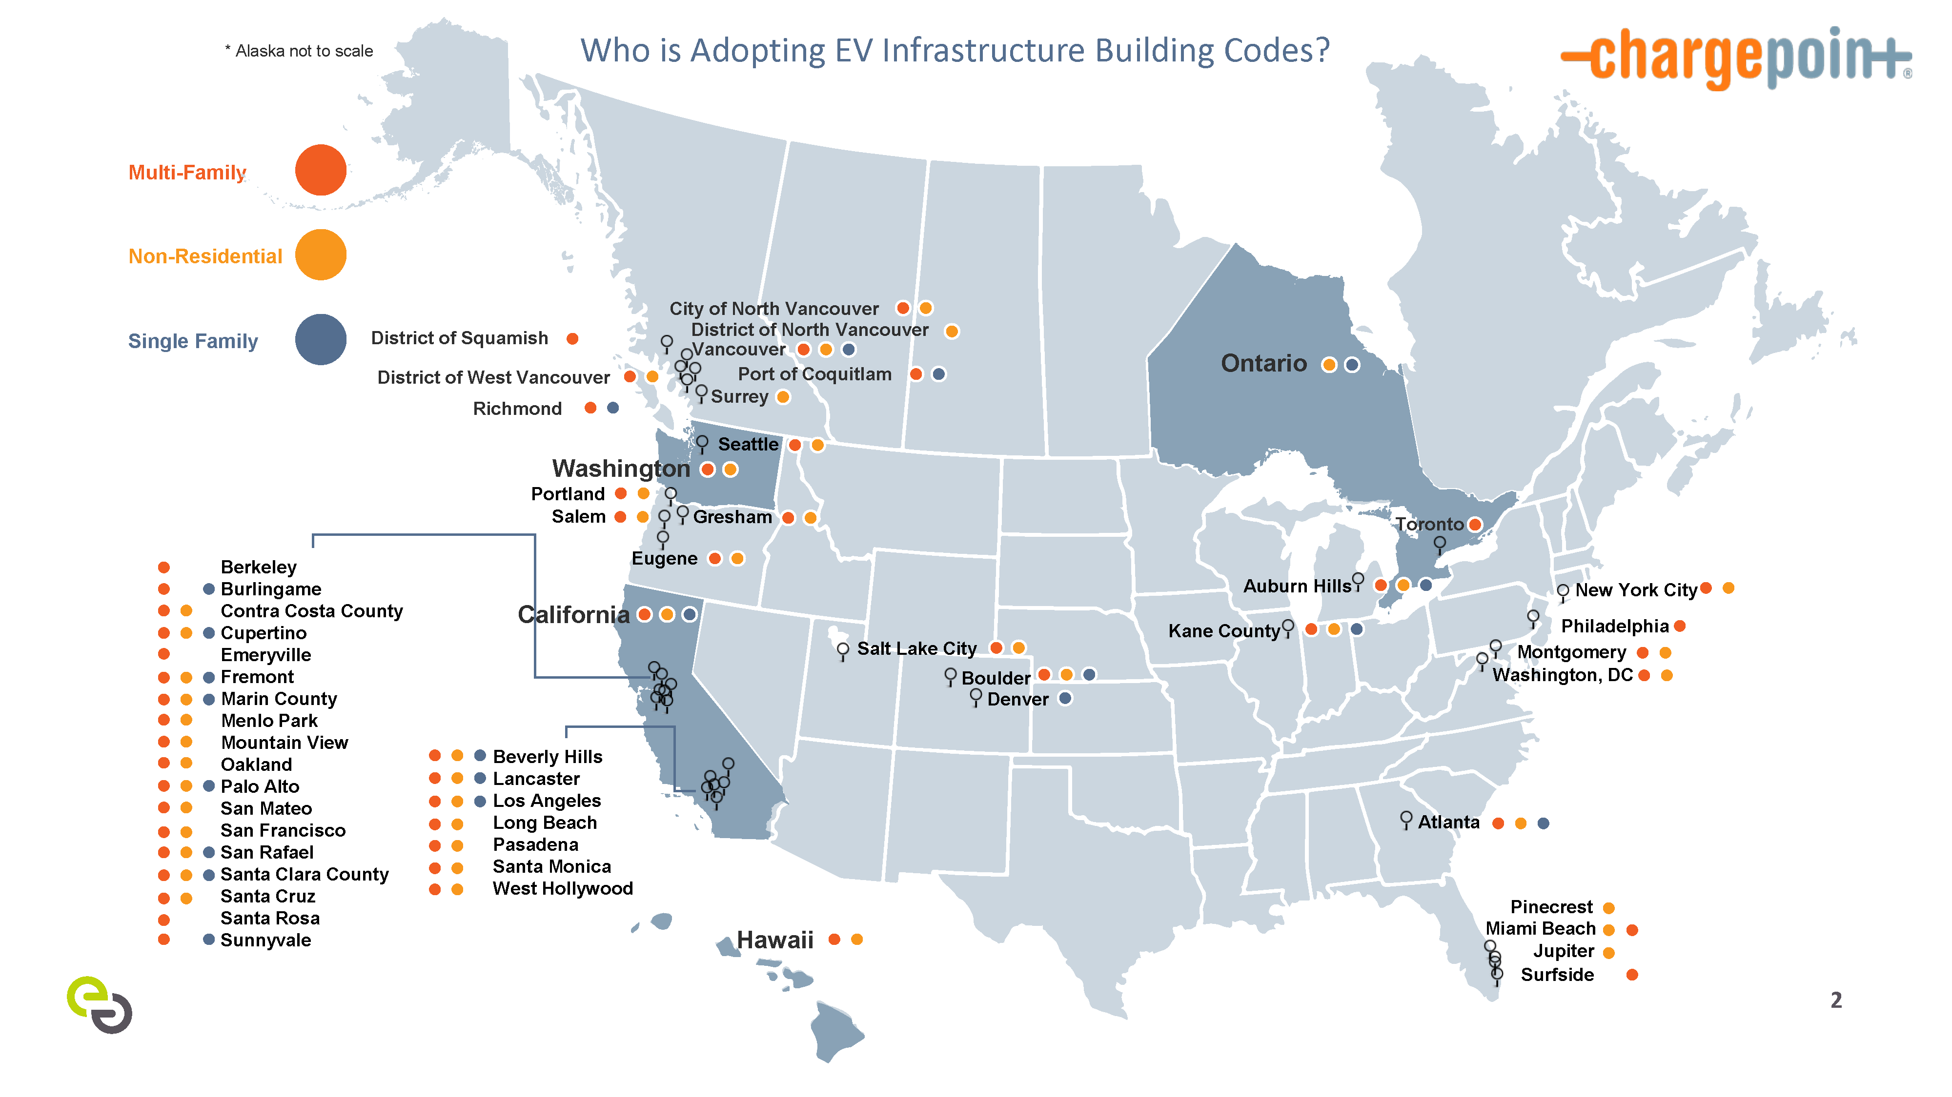
Who HAS adopted building codes?
Source: Energy Solutions, ChargePoint (2018)
Notes:
Date it

Slide 5
Existing CODES
STATE OF WASHINGTON
WAC 51.50.0427 Requires EV charging infrastructure at a min of 5% of parking spaces in new buildings with > 20 parking spots and an electrical room designed to support 20% of stalls with 240V
RCW 19.27.540 Minimum requirement raised to 10% of parking spaces (at least 1) Load management infrastructure may adjust the size and capacity of charging equipment At least 1 parking space or 10% of accessible parking spaces with a charging station
RCW 46.08.185 Requires signage at public parking spaces with charging stations; establishes a parking infraction of $124 for parking without connecting to the charging equipment

Slide 6
Existing CODES
TOWN OF COUPEVILLE
16.12.075 Defines Level 1, 2, and DC fast charger
Establishes applicability of chargers within different land use zones
Establishes standards for:
Signage, per RCW 46.08.185
Accessible parking stalls
Adequate lighting
Charging station equipment design and installation
Notification of voltage levels, fees, safety information, etc.
Charging station access in new facilities for 10% of parking spaces minimum; per RCW 19.27.540
Charging station installation review process

Slide 7
Existing CODES
ISLAND COUNTY
17.06.550.C.4 Within Freeland NMUGA Charging stations may be used in a max of 50% non-handicapped parking spaces Charging stations may be used in handicapped spaces but use is not limited to electric vehicles
17.03.180.Q Outside Freeland NMUGA Charging stations may be counted to meet parking space requirements Charging stations may be installed in accessible spaces but do not count towards accessible requirements

Slide 8
WHAT TO INCLUDE IN CODES?
Level 1, 2, and DC fast charger definition and applicability in different land use zones
Minimum requirement for parking stalls to be EVSE-ready and/or flexible, tiered requirement for larger parking facilities. Separate single-family, multi-family, and non-residential standards
Require sufficient area for electrical infrastructure to serve enough parking spaces with 240V and with capacity to expand
Amend municipal electrical code, if required, to support installation of EVSE charging stations
Require signage pursuant to RCW 46.08.185; potentially require display of voltage levels, fees, safety information, etc.
Require lighting and charging design-related standards consistent with local municipal code
Add requirements to include charging stations for accessible parking spaces
Define permitting and review process for charging station installation

Slide 9
RELEVANT CODES FROM OTHER JURISDICTIONS
KING COUNTY, WA
CITY OF SEATTLE, WA
OTHER JURISDICTIONS
21A.06.XXX Establishes EV parking space requirements for new developments in non-urban areas
Expected to be adopted by 2021
Sections to include definitions of EV readiness, load management systems, parking and circulation standards, EV parking requirements, minimum requirements for electrical rooms in accordance with National Electrical Code, and signage requirements
MUNICIPAL CODE 11.72.15 Sets EV charging station and parking standards and minimum requirements
MUNICIPAL CODE 21.49.070 Allows any municipal facilities with public charging stations to have a fee structure to recoup the capital and operating costs; may be structured to reflect cost of service per kWh, per minute, or a flat fee
ELECTRICAL CODE 625.27 Requires additional space for physical equipment and space planning to install future conduit and panel
CALIFORNIA GREEN BUILDING STANDARDS CODE 5.106.5.3 Provides a calculation for number of required EV charging spaces per total parking spaces in non-residential buildings
INTERNATIONAL BUILDING CODE CE217-19 PART II. R404.2 Provides a calculation for number of required EV charging spaces per total parking spaces in residential and multi-family dwellings
CITY OF DAVIS, CA MUNICIPAL CODE 8.01.060 Provides a calculation for number of required EV charging spaces per total parking spaces in retail, non-retail, and destination zones
CITY OF MILL CREEK, WA MUNICIPAL CODE 17.50 Provides a template for writing charging station-related building codes
CITY OF PALO ALTO, CA MUNICIPAL CODE A4.106.8 & A5.106.5 Provides a template for writing charging station-related building codes for residential and non-residential uses

