Slide 1
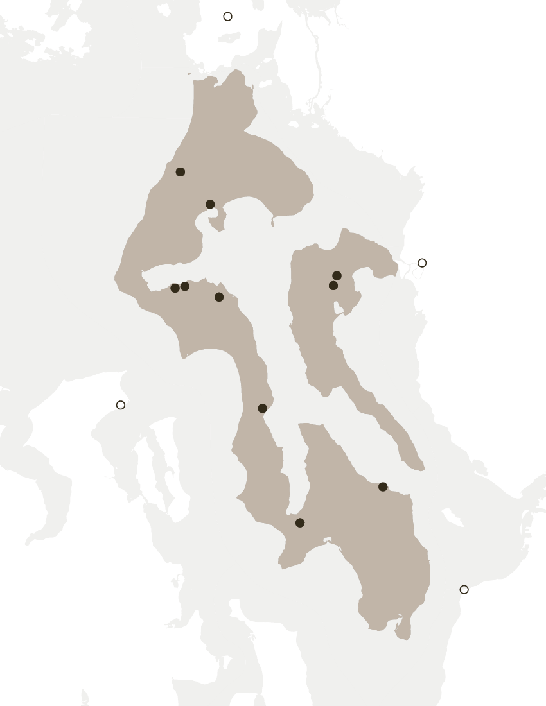
ISLAND REGION VEHICLE ELECTRIFICATION STUDY
Island Regional Transportation Planning Organization
February 12, 2020

Slide 2
Public outreach SURVEY
NOVEMBER 3-30, 2020
430
Total responses

Slide 3
FAMILIARITY WITH ELECTRIC VEHICLES
DO YOU OWN AN ELECTRIC VEHICLE?
WHAT WOULD ENCOURAGE YOU TO PURCHASE AN ELECTRIC VEHICLE?
100% response rate
90% response rate
YES/147
NO/283

Slide 4
Respondent demographics
WHERE DO YOU RESIDE?
Owns an EV
PRE-COVID, HOW MUCH DID YOU DRIVE DAILY?
Does not own an EV
100% response rate
100% response rate

Slide 5
ELECTRIC VEHICLES ON ISLAND COUNTY
DO YOU SEE ANY UNIQUE CHALLENGES OF OWNING AN ELECTRIC VEHICLE ON WHIDBEY AND CAMANO ISLAND TODAY?
91% response rate
INSUFFICIENT CHARGING INFRASTRUCTURE
Owns an EV
Does not own an EV

Slide 6
CHARGING STATIONS ON ISLAND COUNTY
PREFERRED CHARGING LOCATIONS OUTSIDE HOME?
WHAT ARE YOUR PREFERRED PUBLIC CHARGING LOCATIONS?
89% response rate
94% response rate
SECONDARY
PRIMARY
HOW FAR WILL YOU DRIVE FOR PUBLIC CHARGING?
91% response rate
Owns an EV
Does not own an EV

Slide 7

Public charging NEEDS ON ISLAND COUNTY
WHERE IN NORTH WHIDBEY ARE PUBLIC CHARGING STATIONS MOST NEEDED?
91% response rate
Others:
Safeway/Walmart shopping complex, Home Depot, Haggen, NAS Whidbey Movie Theater, Whidbey Golf Course, Gallery Golf Course, Freeland Shell station, McDonalds, Sears, DECA.

Slide 8

Public charging NEEDS ON ISLAND COUNTY
WHERE IN CENTRAL WHIDBEY ARE PUBLIC CHARGING STATIONS MOST NEEDED?
92% response rate
Others:
Coupeville Ferry, Hospital, Freeland Water Park, Coupeville Library/Post Office/Farmer’s Market, Greenbank Store, Red Apple, Front Street.

Slide 9

Public charging NEEDS ON ISLAND COUNTY
WHERE IN SOUTH WHIDBEY ARE PUBLIC CHARGING STATIONS MOST NEEDED?
93% response rate
Others:
Saratoga Woods Trail Head, Freeland central business district, near Clinton Ferry Terminal, Payless parking lot, downtown Langley, Freeland Ace hardware store, Star Store, Cozy’s

Slide 10
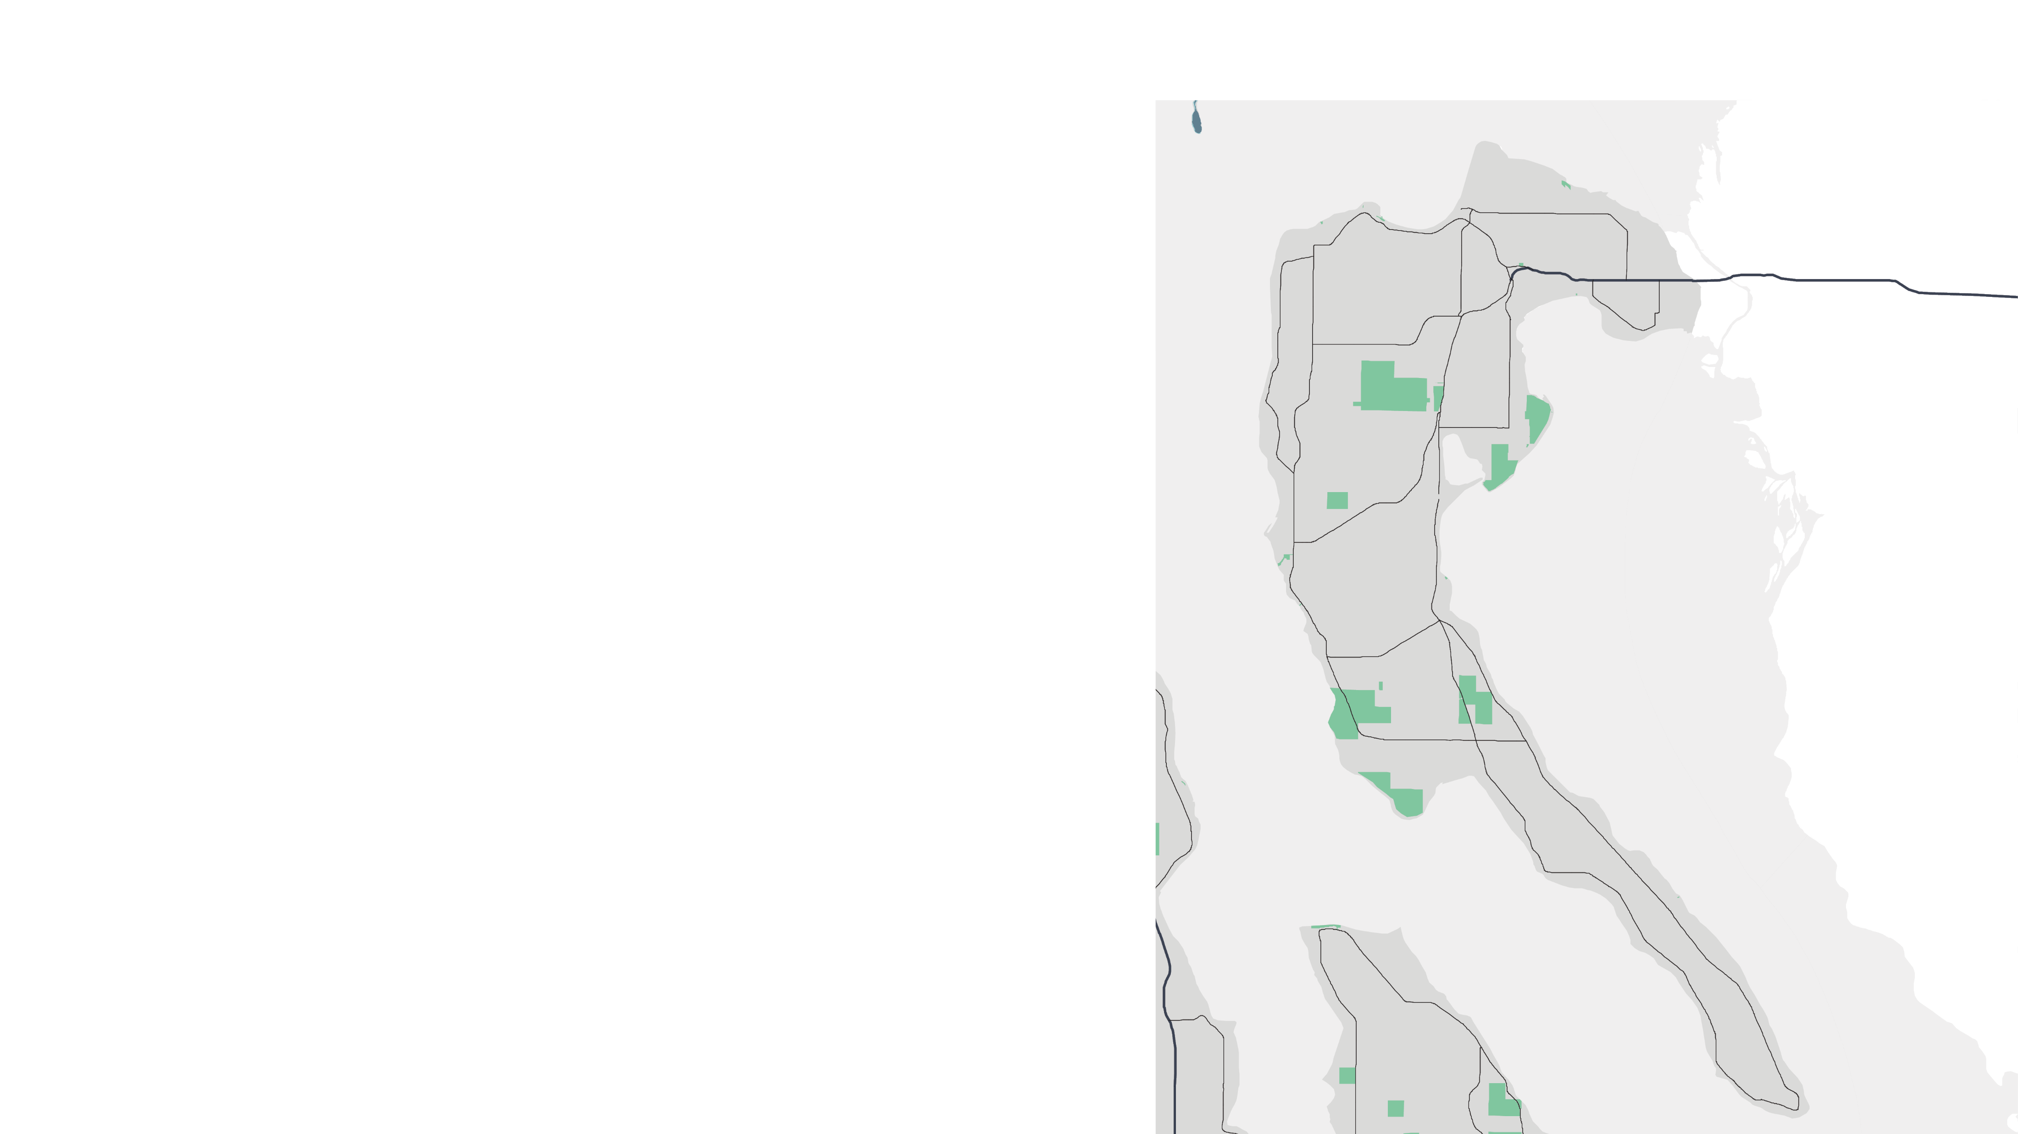
Public charging NEEDS ON ISLAND COUNTY
WHERE IN CAMANO ISLAND ARE PUBLIC CHARGING STATIONS MOST NEEDED?
86% response rate
Others:
IGA Plaza, Elger Bay grocery store, Camano Plaza

Slide 11
WHERE ARE CHARGING STATIONS MOST NEEDED?
91% response rate
Owns an EV
Does not own an EV
TOP 10
Deception Pass State Park
The Goose Community Grocer
Skagit College/Sno-Isle Library
Ken’s Corner
County Administrative Building
Terry’s Corner P&R
Oak Harbor P&R
Clinton P&R
Freeland P&R
Camano Island State Park

Slide 12
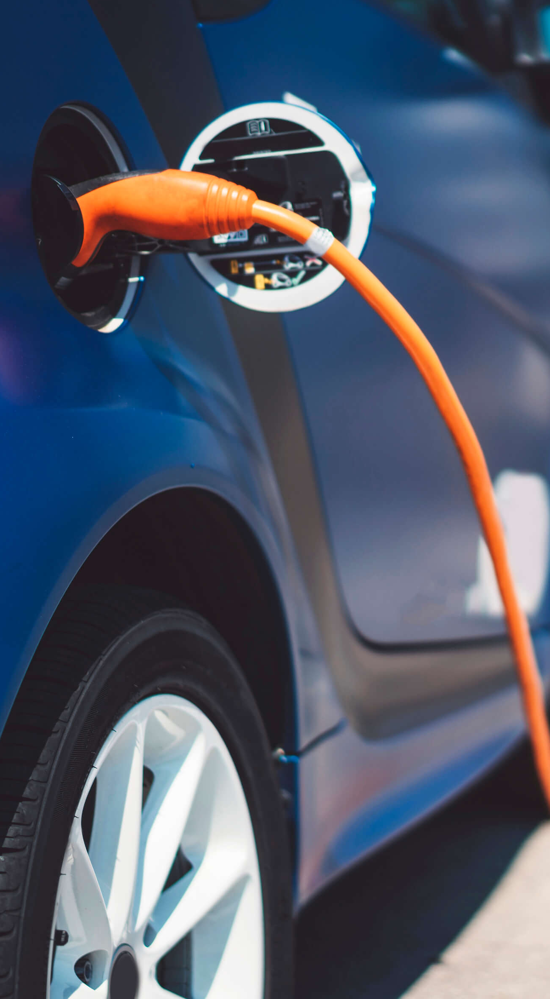
Major TAKEAWAYs from survey
Increasing acceptance of electric vehicles among Island County residents for their positive climate effects and reduced fossil fuel reliance.
Lack of charging stations on Island County was identified as the major concern, esp. at groceries, libraries, and parks
Upfront vehicle costs and lack of sufficient tax rebates and incentives are the other key barriers to electric vehicle ownership.

