Slide 1
Housing
Homelessness
Affordable housing

Slide 2
Agenda
  2020 Homeless Point In Time Count
  1406 Funding
  5 Year Homeless Housing Plan

Slide 3

2020 Homeless Point in Time Count
Island County
January 23, 2020

Slide 4
2020 Point In Time Count Total: 143
Unsheltered: 78, Sheltered: 65

Slide 5
5 year comparison
Total homeless individual count in Island County: 2016-2020
Total homeless individual count in Island County: 2016-2020 has declined since 2016.
Notes:
As you can see overall number down
Last year we had total of 166 and this year we have a total of 143
however this decrease is primarily due to to decrease in our sheltered number
Compass Housing ended contract and closed the Cottages and two TH apartments
Opened Housing Support Center in August of 2016

Slide 6
Household Composition
Unsheltered and Sheltered
Notes:
Note with this slide we are measuring households not individuals.
For unsheltered we had total of 69 households and those were all adult households, no households with children
62 of those households were single adult households
For our sheltered numbers, you will see 8 families with children, but again the vast majority were adult housholds with 38 and of those 38, 35 were singles
Data shows we are doing very well with households with children
Able to house very quickly or keep them in their existing housing with rental assistance
Vast majority of homeless people we are seeing both sheltered and unsheltered are single adults

Slide 7
Gender
Unsheltered and Sheltered
Notes:
Continuing with the demographics, we look at gender
For unsheltered – 75% of the people we encountered during PIT were men.
For sheltered households it is a closer split, but this is largely a product of what is available. A large section of our emergency housing options are for women or women and children.
Overall, we are seeing mostly single men in need of services.

Slide 8
2020 Homeless Point In Time Count
Chronically Homeless
Region | Chronically Homeless Unsheltered | Chronically Homeless Sheltered * | Total Chronically Homeless
North Whidbey | 32 | 13 | 45
Central Whidbey | 4 | 4 | 8
South Whidbey | 9 | 3 | 12
Camano | 2 | 0 | 2
Total | 47 | 20 | 67
Complexities
Macro Level Factors: Poverty, lack of employment, low welfare, lack of affordable housing
Personal Vulnerability: Childhood abuse or neglect, mental health symptoms, impoverished social networks
Substance Use due to severe childhood trauma
Lack of supportive housing
* Sheltered includes The Haven, Marjie’s House, House of Hope, Ryan’s House for Youth, Whidbey House and Ireland House
Notes:
We are now tracking sheltered chronically homeless because we are referring more chronically homeless people to our shelters per recommendations from Commerce to serve the most vulnerable.
This year looking at chronically homeless numbers for both our unsheltered and sheltered pop.
We are seeing more people with significant behavioral health issues, physical, SA.
Dept of Commerce asking us to serve the most vulnerable and because of that we are sending increasingly complex cases to our partners
Concern that they are being asked to do a lot more with people with much large needs and no more resources

Slide 9
Chronically Homeless
5 Year Comparison
Total: 48
Total: 67
ƚ2017 is the year the Haven opened. This occurred after the Point In Time Count for that year.
*2019 is the year we began to track chronically homeless for both sheltered and unsheltered.

Slide 10
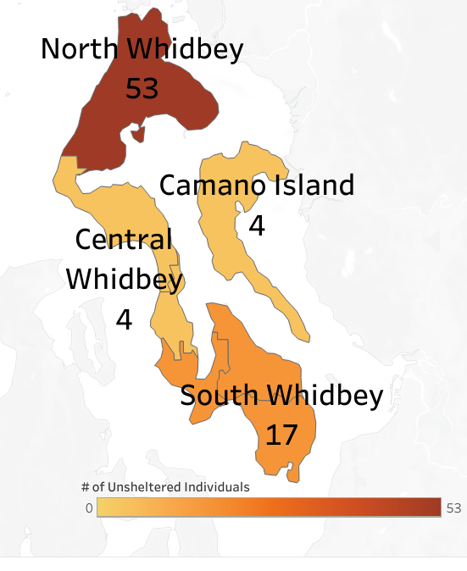
Unsheltered County Distribution Map
2020 Homeless Point In Time Count

Slide 11
Unsheltered
Regional 5 Year Comparison

Slide 12
Demographics of Unsheltered
Income and Disability
42%
Of unsheltered individuals reported having a source of income
Notes:
Disabilities, income, circumstances, household
Leah

Slide 13
Emergency and Temporary Housing Stock
Organizations | Emergency Shelter | Transitional Housing | Night to Night Shelter
CADA | 3 units | 4 units | -
Opportunity Council | 5 units | 4 units | -
Ryan’s House for Youth | 12 beds | 16 beds | -
Whidbey Homeless Coalition | 4 rooms | - | 30 beds
Supportive Housing | - | - | -
Partner Organizations
Note: Outside of our contracted partners, we also work with Oxford Houses, Sober Living Facilities, Assisted Living Facilities, Adult Family Homes and Diversion.
Notes:
Talking point: 3 Sober living facilities, Oxford House each for men and women and one other sober living house. All located in Oak Harbor. (Add astericks – Oxford House, Assisted living, adult family home)
Different terminology because each facility is set up differently – everything from apartments to a cot
This illustrates the few housing resources we have to work with

Slide 14
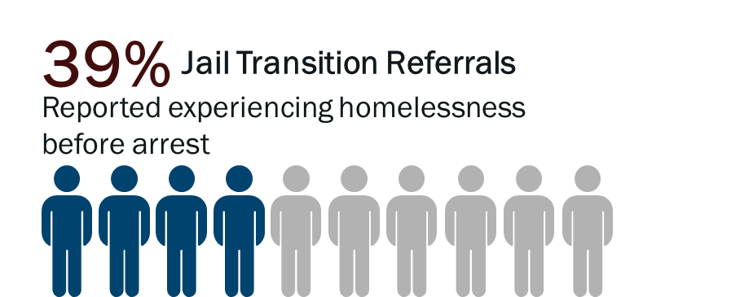
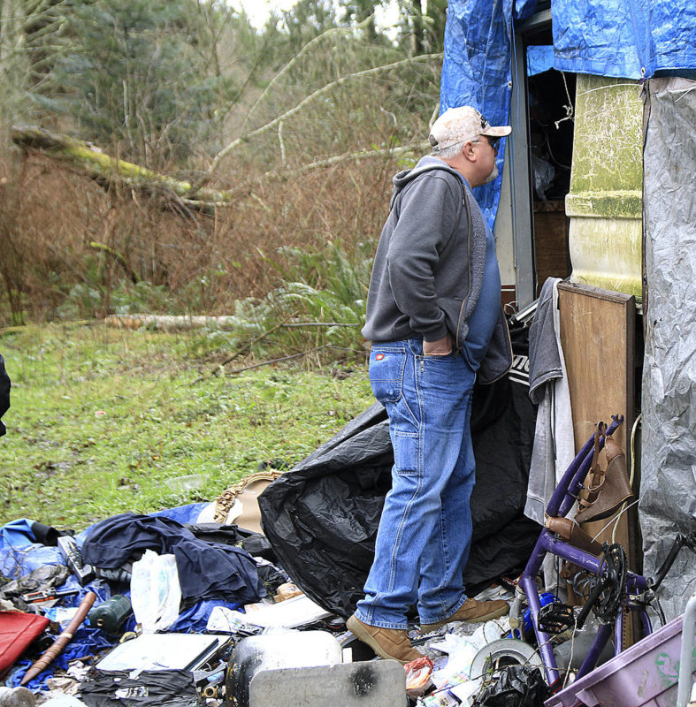
Cross program Collaboration
53
Requested Referrals for Housing Assistance
Specified “housing” as an area of concern or need to address
Photo by Laura Guido/Whidbey News-Times Dennis Phillips, of Island County Human Services
Notes:
Joanne
TBD
Photo by Laura Guido/Whidbey News-Times Dennis Phillips, of Island County Human Services, calls inside an RV to see if anyone is living there as part of the annual Point in Time count. Volunteers tried to get as accurate as a number during the one-day count, required by the federal and state governments.
We again this year compared our surveys with HSC data and a significant number have not come through the HSC. We know we are not engaging with a certain segment with our homeless population. We are seeing some better outcomes through our cross program collaboration and over the last year we have gotten 16 people positive housing interventions which could include treatment, sober living, diversion
For example, on the day of the PIT met man who came here for job at Nickels brother, got hurt, lost job and became homeless. Very next day we were able to use diversion funds to get him back to his community. In addition the next morning there were 5 more people in our office looking for solutions.

Slide 15
HB 1406
Actual Revenue (January & February, 2020) $ 26,811
  -Annual CAP $146,440
  A. Eligible uses of the funds:
          Projects must serve those at 60% AMI and below
          Acquire, rehabilitate, or construct affordable housing, land acquisition,
          down payment assistance, or home repair,
          Fund operations & maintenance costs of new units of Affordable or Supportive Housing
          Rental assistance to tenants
  B. Local uses and process:
  Affordable Housing Fund – 2019 Revenue
  $128,501 (max O&M 25%) Bal $93,376 (Housing Advisory Board)
  Estimated Total- Both Funds
  $274,941 (less AH 25%) $239,815
Notes:
Emily

Slide 16
5 Year Homeless Housing Plan
2018 Washington State Legislature – HB 1570 (RCW 43.185C.040)
        Removed sunset on document recording fees
        Increased Fees on some recorded documents
        Specified additional performance and reporting
        requirements.
        Changed required components for Homeless Housing Plans
Notes:
Will get bullets for that
Joanne

Slide 17
5 Year Homeless Housing Plan
Next Steps
  Review Commerce comments upon receipt
  Follow-up with Board of County Commissioners
  Schedule work session presentation
  Begin Implementation of Plan

Slide 18
Department of Commerce
Local Homeless Plan Guidelines
Summary of Requirements: (RCW 43.185C.040)
Local Homeless Housing Task Force shall prepare and recommend a DRAFT five-year homeless housing plan by December 2019.
Local plan must be consistent with Commerce statewide guidelines and state objectives
Must be aimed at eliminating homelessness
May include other objectives and performance measures and may include recommendations for the state legislature and or commerce.
Membership on the Homeless Housing Task Force must include people with lived experience of homelessness and also representatives of counties, cities, towns, housing authorities, and other systems that serve the homeless population.

Slide 19
Homeless Housing Task Force
Acknowledgements
Island County thanks the many community leaders that participated in the creation of the 5 Year Homeless Housing Plan. Their time and expertise over five months contributed to the development of this comprehensive plan that will guide us into the future as we work together to make homelessness rare, brief and one time.

Slide 20
Statewide & Local Objectives
Five State Objectives required to be included in local plans
  Quickly identify and engage people experiencing homelessness
  Prioritize housing for people with greatest needs
  Operate an effective and efficient homeless crisis response system that swiftly moves people into to stable permanent housing.
  Project the impact of the fully implemented local plans on the number of households housed and the number of households left unsheltered, assuming existing resources and state polities
  Address racial disparities among people experiencing homelessness.
Two Local Objectives
  Preserve existing & increase new Affordable Housing
  Expand community engagement

Slide 21
Task Force Process
  Established Vision, Mission, Goal and Purpose
  A Look Back- Reviewed 2016 Homeless Plan, accomplishments and work to be done.
  Data review: Analyzed Scope of Homeless today - PIT, HMIS and Housing Support Center, Youth Homelessness in the schools
  Reviewed Current Resources; funding, allowable interventions, homeless housing inventory and affordable housing
  Determined barriers and gaps in current system
  Draft Action Plan Matrix
    5 State Objectives with core strategies and correlating action steps
    2 Local Objectives with core strategies and correlating action step
Notes:
Joanne
Keep
Speak to New terminology guidance from commerce broadening who we work with, the expansion of the systems bringing together of systems…this being the first slide in the presentation of the five year plan

